Slide 1
College of Education and Human Development
Understanding School Choice in Delaware

Slide 2
Welcome
Thank you for joining us for the first of our Parenting Workshops at the ELC.
Introductions

Slide 3
Is my child ready for kindergarten?
Does my child have to be enrolled in kindergarten? Yes, it is mandatory in the stat of Delaware to be enrolled in school at the age of 5 ears.
How old does my child need to be to enroll in kindergarten? Your child must be 5 years old by August 31 to begin Kindergarten for the new school year.

Slide 4
What is School Choice?
School Choice is a program that began in the 1996-1997 school year. The purpose of the program is to increase access to educational opportunity for all children throughout the State regardless of where they may live.
Families who reside in the district where they live will have first choice to their local school. It is only after local families enroll that open spots will be filled through School Choice applicants.

Slide 5
Where do I begin?
To begin understanding School Choice visit https://www.schoolchoicede.org/.
You will find:
list of participating public school districts and charter schools in Delaware.
Application for applying for the school of your choice.
Deadlines for application
ACTION: Let’s explore together.

Slide 6
How do I select the best school for my child?
Now that I know where to go to enroll my child, how do I select the best school for my child?
Finding a great school in Delaware

Slide 7
What are my next steps?

Slide 8
Articles
What Kindergarten is Right for My Child?
Transitioning to Kindergarten
Sign Here! Three Tips for Navigating the IEP Process

Slide 9
Resources
School Choice Information, Department of Education
Title 14, Chapter 4. School District Enrollment Choice Program
Delaware Readiness Teams

Slide 10
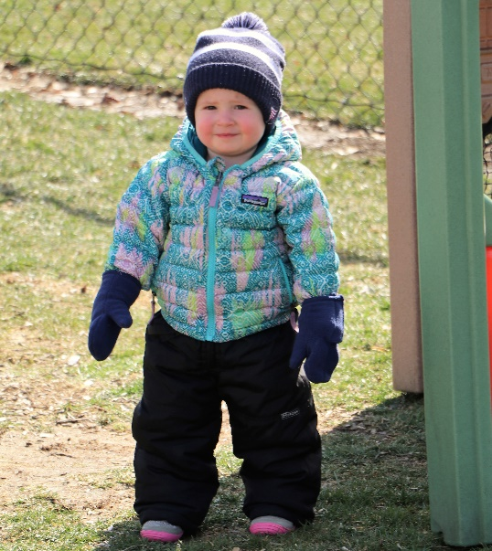
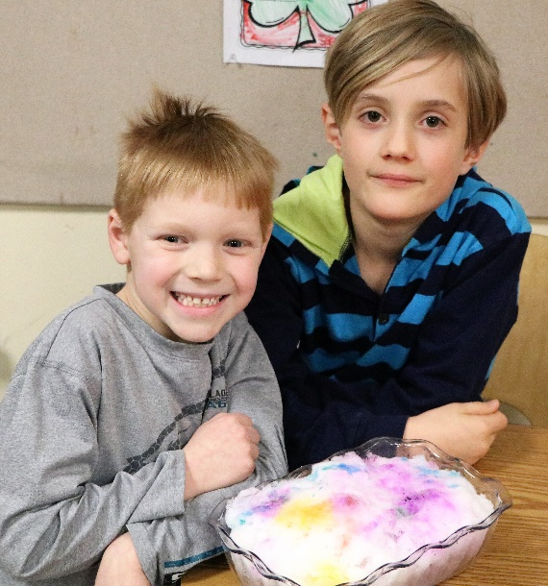
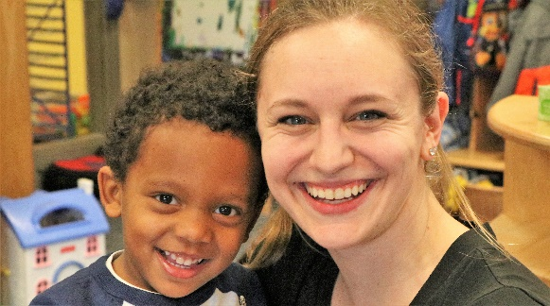
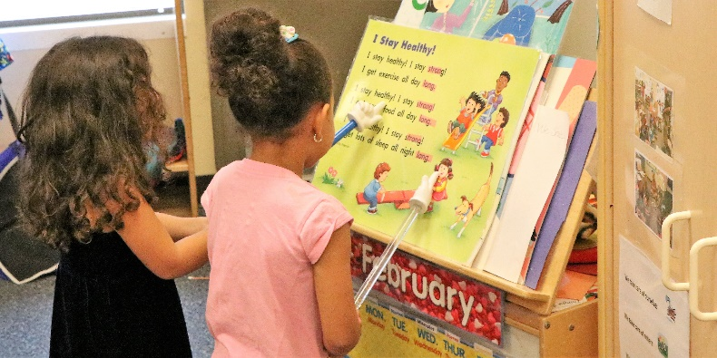
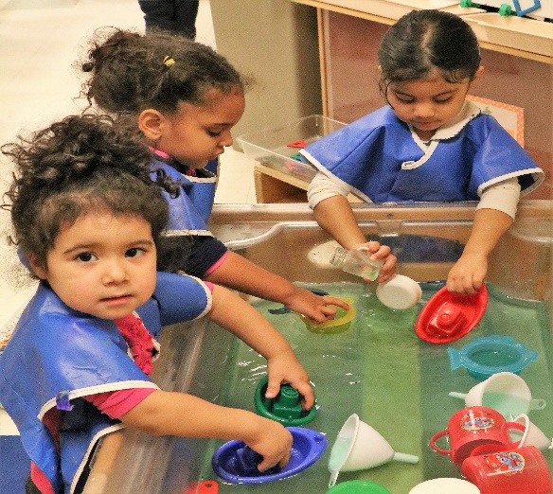
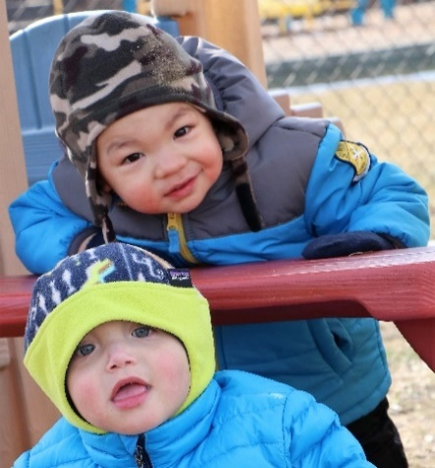
Thank you!

Slide 11
Early Learning Center Information

